Slide 1


Your Cycle & You
Notes:
Helena
Callahan: “If you are looking for organization for the final presentations: you are trying to sell us your app! Imagine we are investors/consumers/etc. 10 minutes talking, 10 minutes demo would be a good split (yes, you can play on the margins there, so something like 12 minutes talking/8 minutes demo would be fine). Up to 10 minutes Q&A. No, you do not have to get dressed up for the presentations, but I would like all of your cameras on when you present.”

Slide 2
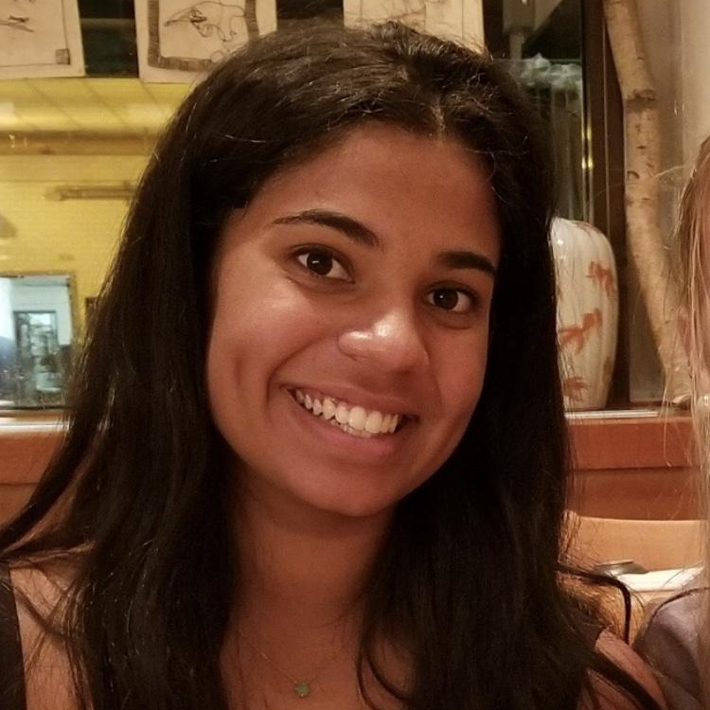


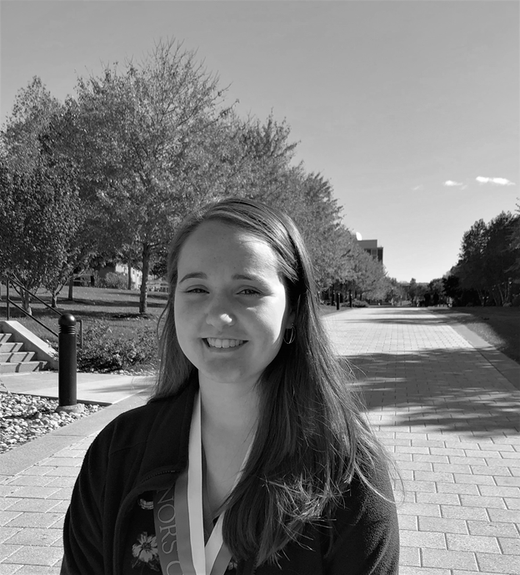

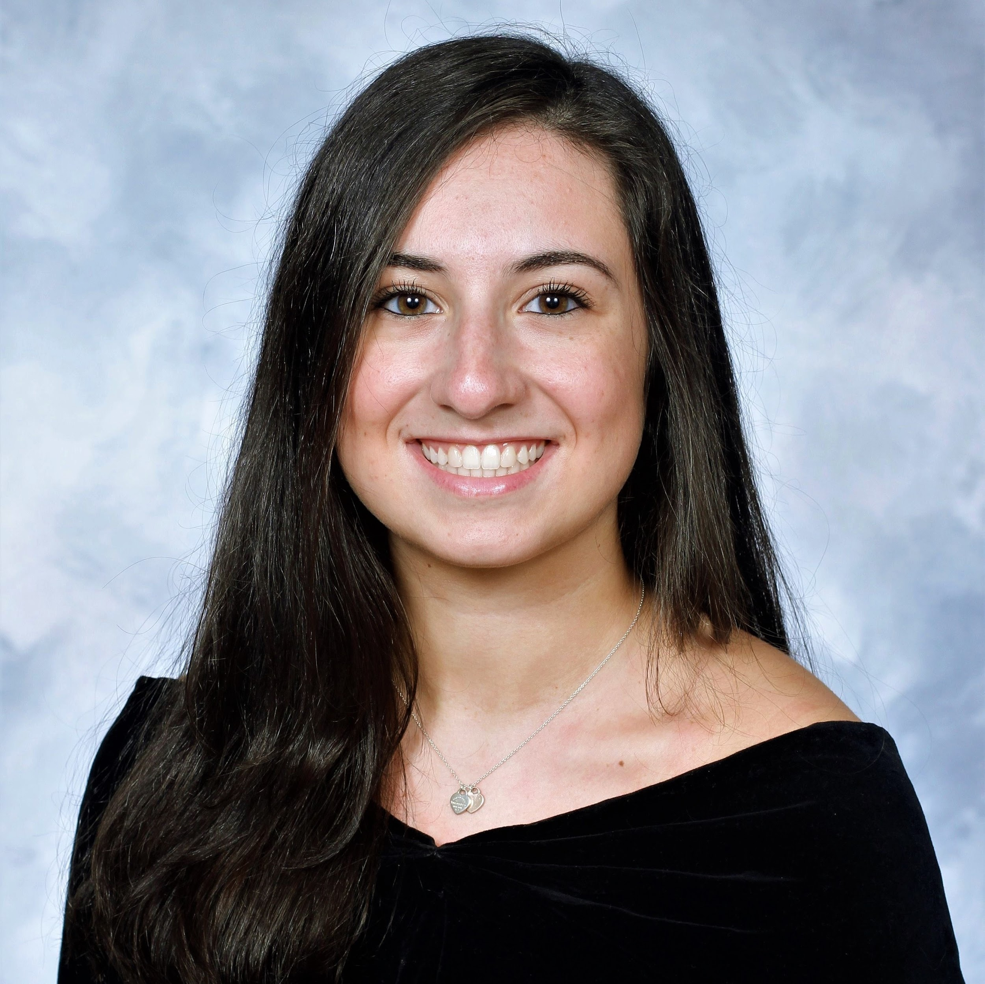

Our Team
Simran
Nambiar
Manya
Trehan
Virginia
Barnes
Helena
O’Sullivan
Lauren
McAlarney
Erica
Bertolozzi
Notes:
Everyone
Name
Grade
Major

Slide 3
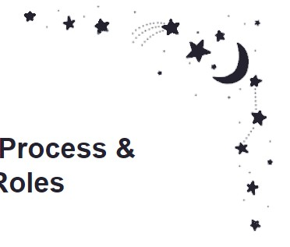
Agenda
01
Problem Space
02
What is Luna
03
Design Process
04
Demo
05
Profitability
06
Future
Notes:
Simi
Problem Space
What is Luna
Our Design Process
- Angular Development
- Database
- API Design
- Demo
- Profitability
- Future

Slide 4
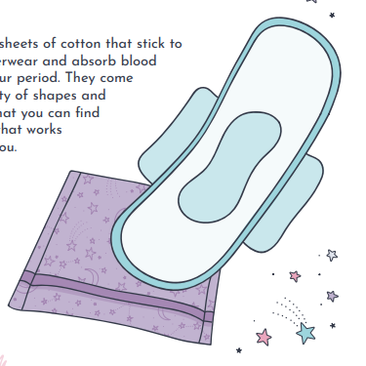
Problem Space
Taboos surrounding periods
Users forget to record daily symptoms and period check-ins
Users fail to check for their expected start date
Lack of guidance for uninformed users
No non-subtle applications
Other applications are hyper feminine
Notes:
Simi
Society has created many taboos surrounding periods. This leads to uninformed young people who do not know the facts about their cycle and bodies, which then leads to unhealthy habits and practices. Therefore there is a need for increased accessibility of helpful information about menstruation.
People who menstruate need a way to track their cycles. Existing applications fulfill this task. However, many users forget to record daily symptoms and period check-ins. Additionally, users fail to check the application to see their expected start date. This leaves users ill-prepared when their period begins. Therefore, there is a need for period tracker applications to send more visible and convenient notifications to users.
Another issue with the majority of apps is that none of them are targeted towards the younger, usually uneducated, girls. Some girls have never been taught what their body is doing and how to take care of their symptoms. Since it is such a stigmatized topic, these girls are left in the dark to try and learn for themselves about their own body and what they should do. Likewise, there is a lack of access to this type of information and education in developing countries. Therefore, there is a need for easily accessible and accurate menstruation information.
Existing period tracker applications are very showy and non-subtle, usually with the words “Period Tracker” in the title. Many users want to keep this private, therefore, there is a need for aperiod tracker. Further, some users might not identify as female. Existing applications are decorated with pinks, flowers, and butterflies. There is a need for a period tracker application that gives users the option of a less “girly” interface.

Slide 5
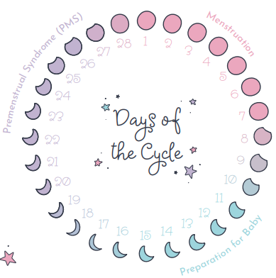

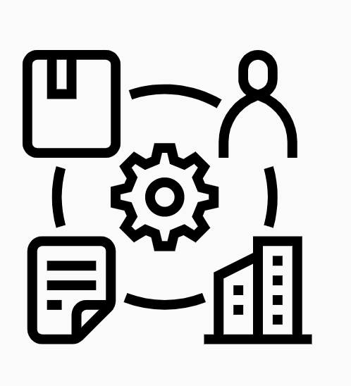

What is Luna?
What does it do?
How does it work?
How does it stand out from
the competition?
Notes:
Lauren

Slide 6
Luna’s Core Features
Help users stay organized and educated and improve awareness about menstruation
Provide a means of tracking period-related events
Notes:
Helena

Slide 7
User Benefits
User-Friendly
A Secure Environment
Accessible
Consistent Layout
Notes:
Helena

Slide 8
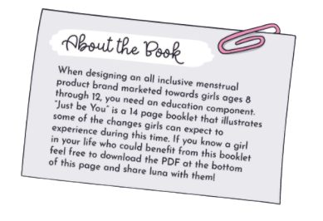
Our Design Process
Step 1:
Wireframing
Step 2:
HTML
Step 3:
CSS
Step 5:
Database Creation and Integration
Step 4:
Angular Development
Step 6:
API Design
Notes:
Lauren

Slide 9
Angular Development
LunaApp
luna
server.js
package.json
README
INSTALL
API
SECURITY
src
app
assets
home
login
calendar
tracker
shopping
learn
Notes:
Erica

Slide 10
Database
Name,
Preview,
Link,
Category
Username,
StartDate,
PeriodLength,
CycleLength,
Mood,
Sleep,
Symptoms
Articles
Cycle Tracking
Product Name,
Link,
Category
Full_Name,
Password,
Email,
Photo_URL,
Join_Date,
App_Mode,
Age
MongoDB
Shopping Page
Users
Notes:
Erica

Slide 11
API Design - GET /api/articles
Return Values
Public API
200 : OK, JSON of All Articles
500: Internal Server Error
Articles.find()
GET /api/articles
MongoDB
All Articles
JSON of All Articles
Notes:
Virginia - our first public API is located at /api/articles.
This will find all articles from our database, and return them in JSON format to the user on Success.
If the user types in an unfound URL, 404 is returned, and if there was an error connecting to the database, a 500 Internal Server Error is returned

Slide 12
API Design - GET /api/shop-items
Return Values
Public API
200 : OK, JSON of All Articles
500: Internal Server Error
Shopping Page.find()
GET /api/shop-items
MongoDB
All Shopping Items
JSON of All Shopping Items
Notes:
Virginia - our second public API is located at /api/shop-items and has the exact same behavior as /api/articles.
This will find all shop-items from our database, and return them in JSON format to the user on Success.
Again, if the user types in an unfound URL, 404 is returned, and if there was an error connecting to the database, a 500 Internal Server Error is returned

Slide 13
API Design - GET /trackerCSV
Return Values
Public API
200 : OK, CSV of Cycle Tracking data
500: Internal Server Error
Cycle Tracking.find()
GET /trackerCSV
MongoDB
All Cycle Tracking
CSV of data
Notes:
Virginia
The next API we have is GET at /trackerCSV.
This API is called from a button on the tracker page. It gives users the ability to download a CSV file of other users’ data (like symptoms or cycle length) so they can see what other people are experiencing and compare their own symptoms. I do want to stress that all information shared is anonymous.
Again, if the user types in an unfound URL, 404 is returned, and if there was an error connecting to the database, a 500 Internal Server Error is returned

Slide 14
API Design - POST /infopost
Return Values
Public API
200 : OK, CSV of Cycle Tracking data
500: Internal Server Error
Users.insertOne(data)
POST /infopost
MongoDB
Success Response
Success Response
Notes:
Virginia
We have a POST at /infopost.
This API is called from a submit button on the tracker page.
This API sends all of the user inputted data on the tracking page (i.e., length of cycle, mood, sleep, symptoms, etc.) to our MongoDB Collection, Cycle Tracking.

Slide 15
Mailthis.to API
Public API
Return Values
Post
Users are able to ask any question they may have regarding their cycle and ask Team luna. On the Tracking Page, users will find a form where they can ask a question. An email will be sent to teamLuna containing the user’s question and email.
Success Response
Email Success Response
Notes:
Manya

Slide 16
Demo
Notes:
Erica
----
Learn Page
To increase access to helpful menstruation information and destigmatize menstrual care, our application, luna, has a Learn area, shown here. This area will house answers to frequently asked questions (FAQs) and verified articles covering a range of topics including what to expect for a first period, birth control options, hygiene products, and more.
If you click on either the title of an article or the "Read more" button, you will be redirected to the article's webpage. Further, you can read a preview of the article from our page.
Currently these articles are stored in a json file. Our server reads from the json file and displays the articles shown.
Eventually, the articles will be moved over to a database and angular will be used to display them.
These articles are also the main source for the API we will provide.
Currently the search bar has no functionality, but as a next step, we will allow the user to search for keywords and display articles that have that key word in the title. Further, we want to have buttons under the search bar of different categories, that way if a user is curious about a certain topic they can easily filter all of the articles having to do with that specific topic.
That's all for the learn page :)
----

Slide 17
How will luna Make Money?
As part of our phase two development process, we will be introducing coupons for various stores that sell period related products
A user can use this coupon at the desired location. In turn, luna will receive a 2% commission on the sale amount from the store
It is a win-win-win situation for the store (increased sales), luna users (savings) and luna (income)
Notes:
Manya

Slide 18
Future of
Search bar on the Learn page
Improved Sign-In/Logout
User Sessions
Notifications
CSS Finalization
Notes:
Helena
NEEDS TO BE ADDED TO

Slide 19
Thank You. Questions?
Notes:
Helena

Slide 20
Extra Content

Slide 21
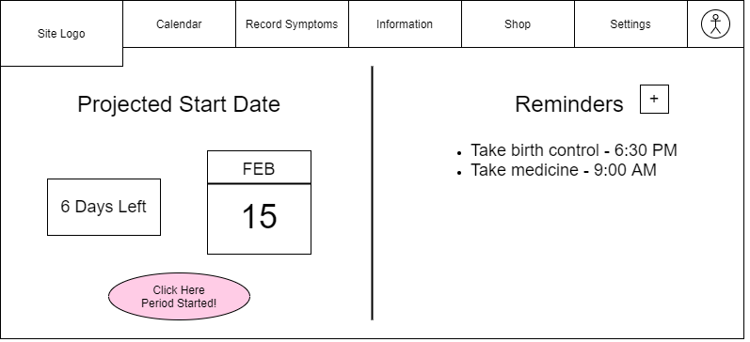
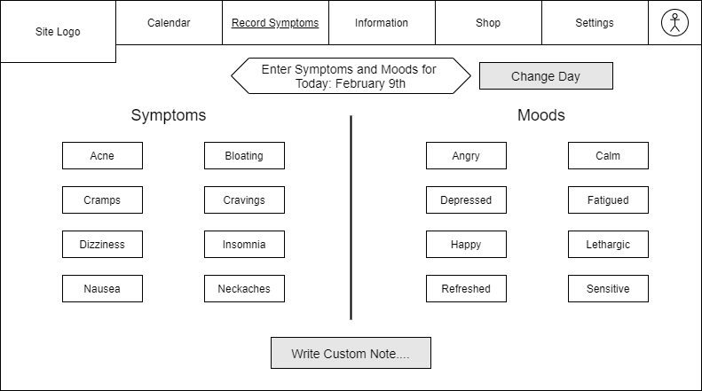
Wireframes
Wireframe 1: Home Page
Wireframe 2: Tracking Page
Notes:
Lauren

